Slide 1
Linux
April-2022

Slide 2

In a world without walls who needs windows and gates?

Slide 3
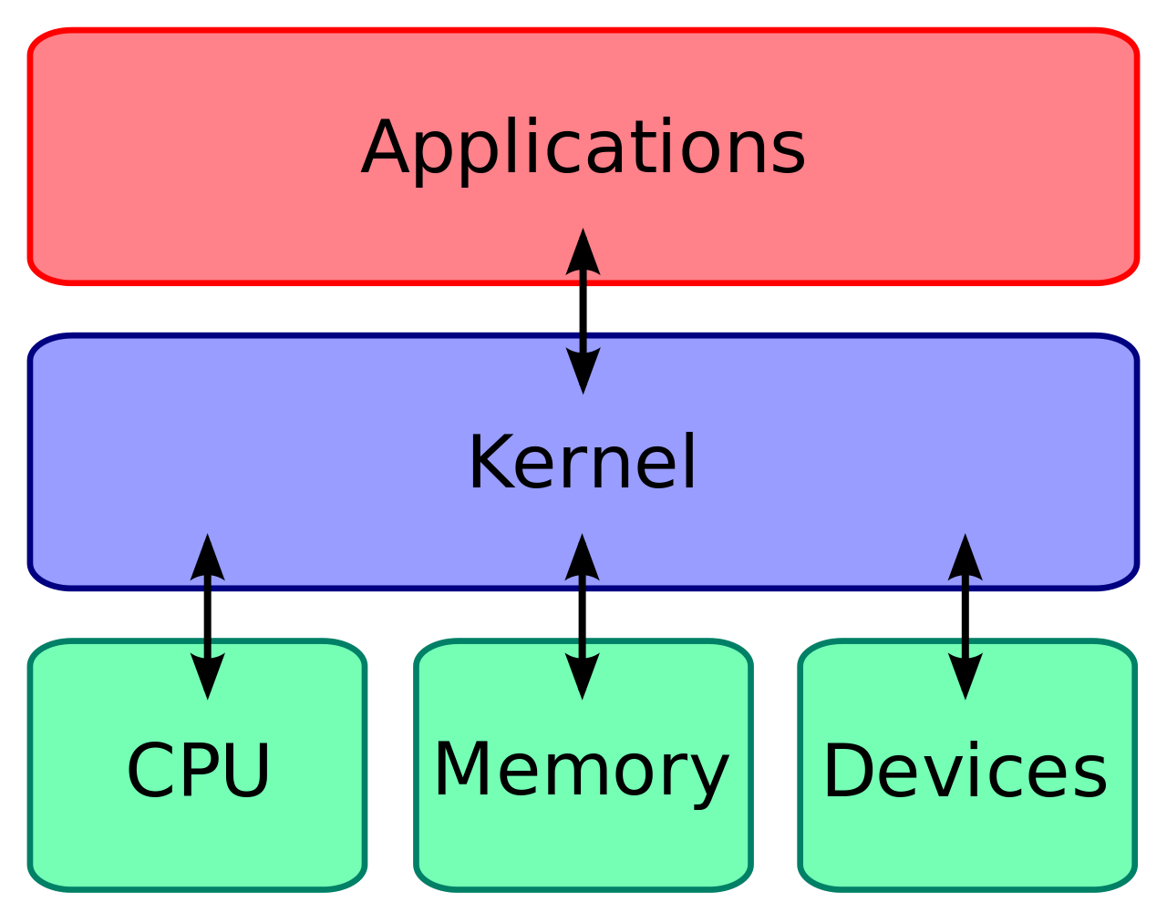

Slide 4
linux VS gnu/linux

Slide 5
There are different distros and different desktops
UBUNTU
ARCH
FEDORA
MINT
DEBIAN
KDE
cinnamon
gnome
xfce

Slide 6
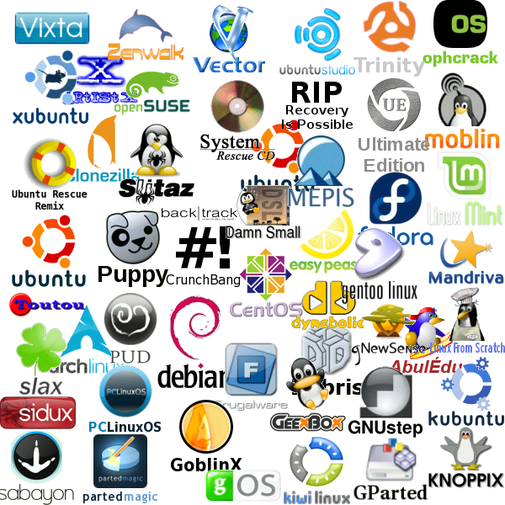
linux distros
UBUNTU
ARCH
FEDORA
MINT
DEBIAN

Slide 7
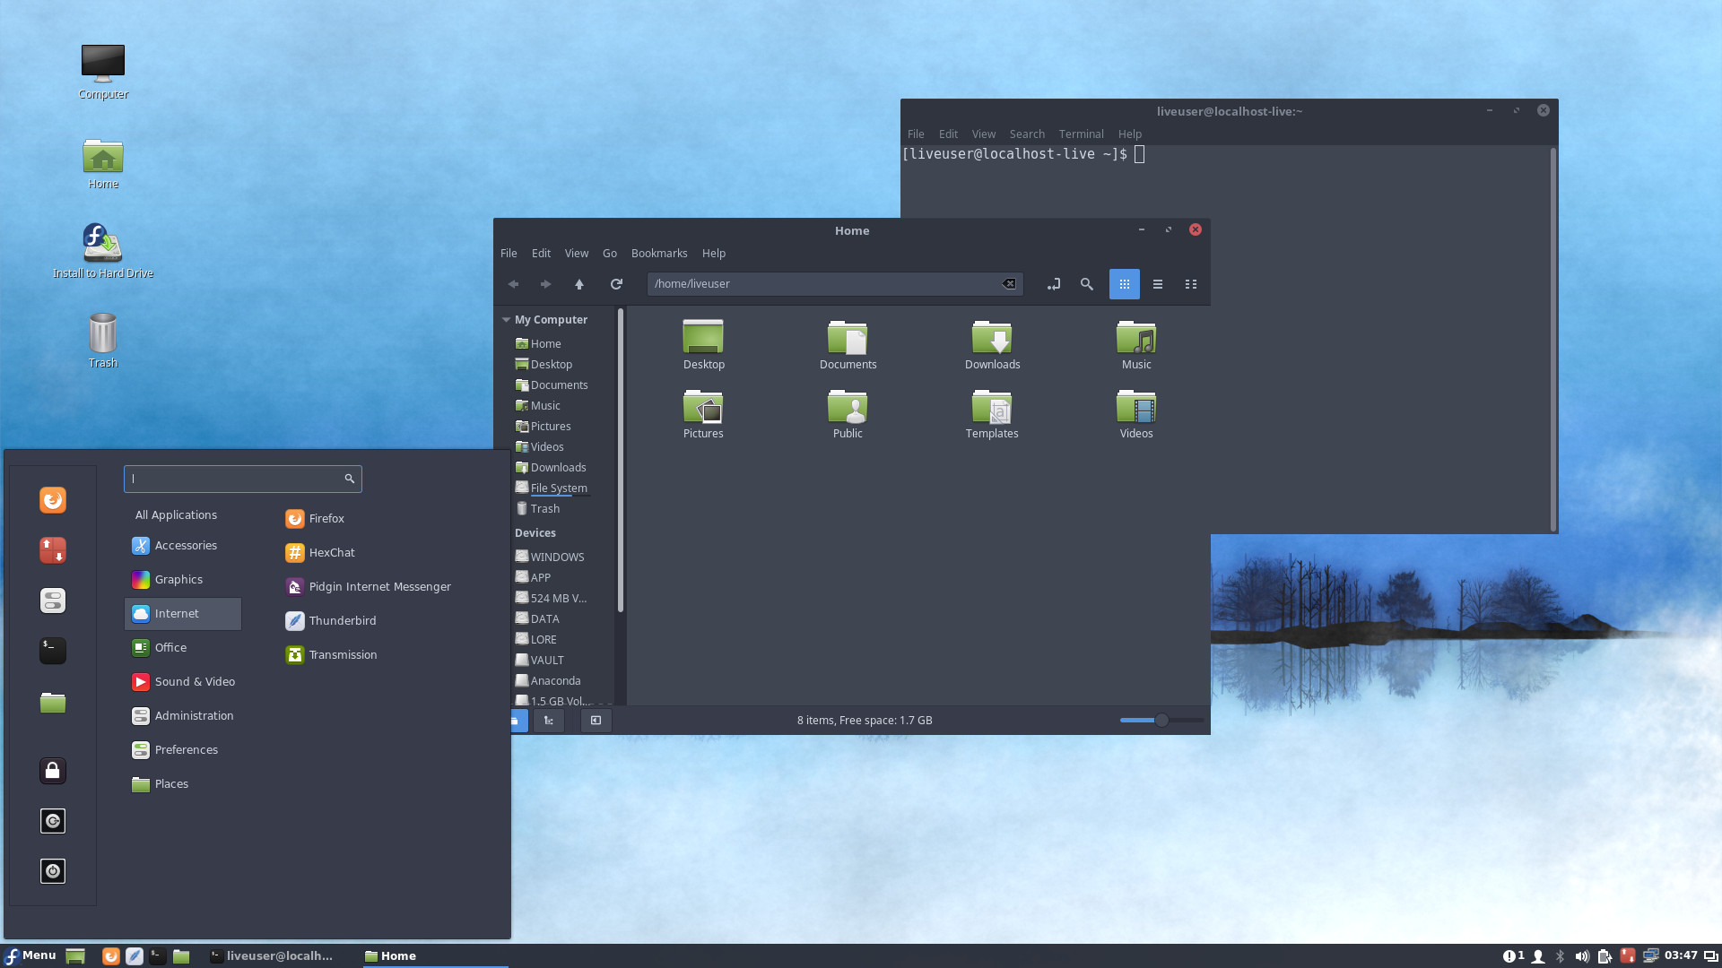

Fedora

Slide 8
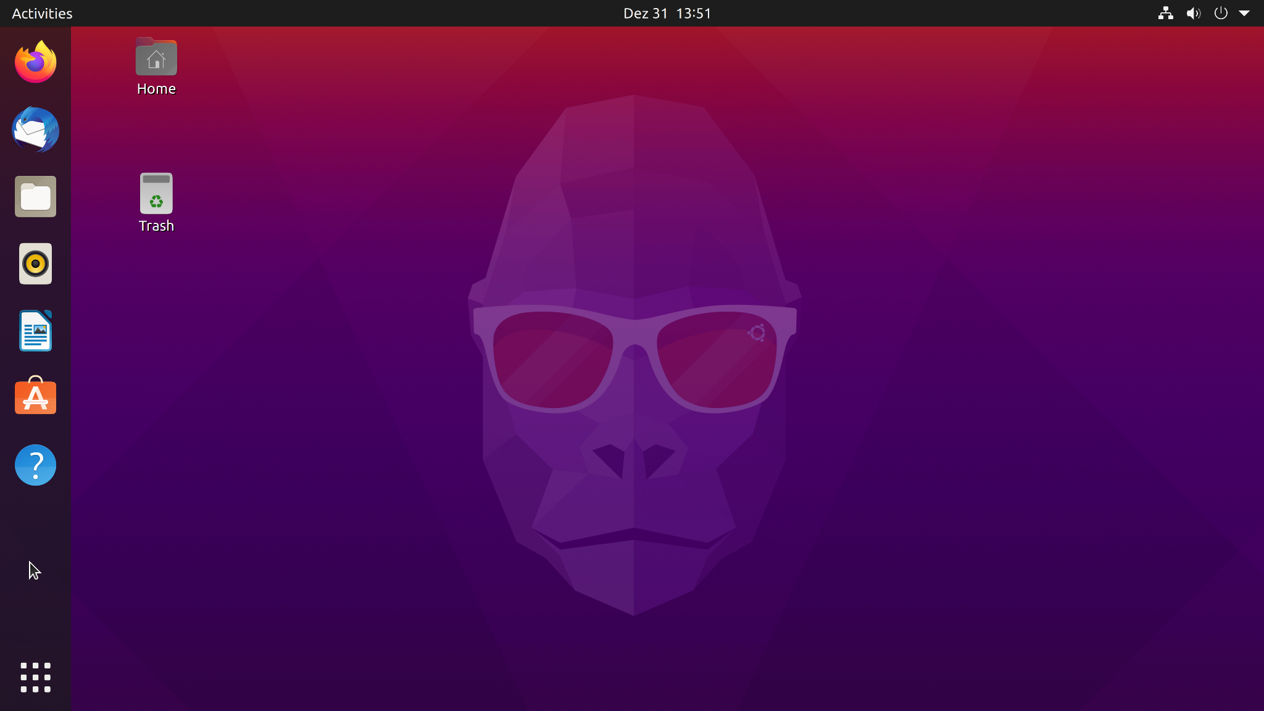

UBUNTU

Slide 9
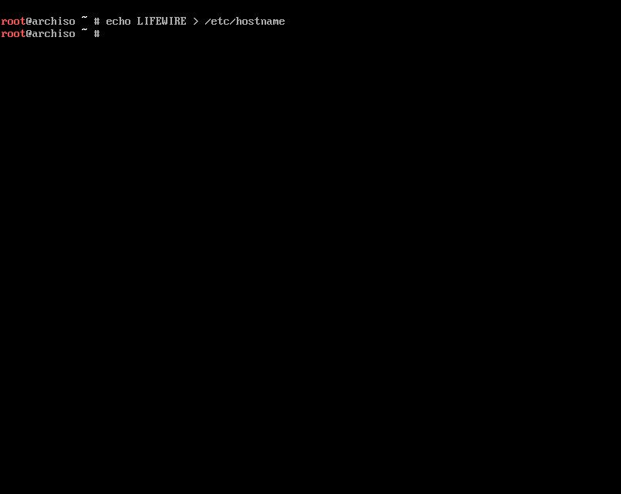

Arch Linux

Slide 10
best desktop environments for linux
KDE
cinnamon
gnome
xfce

Slide 11
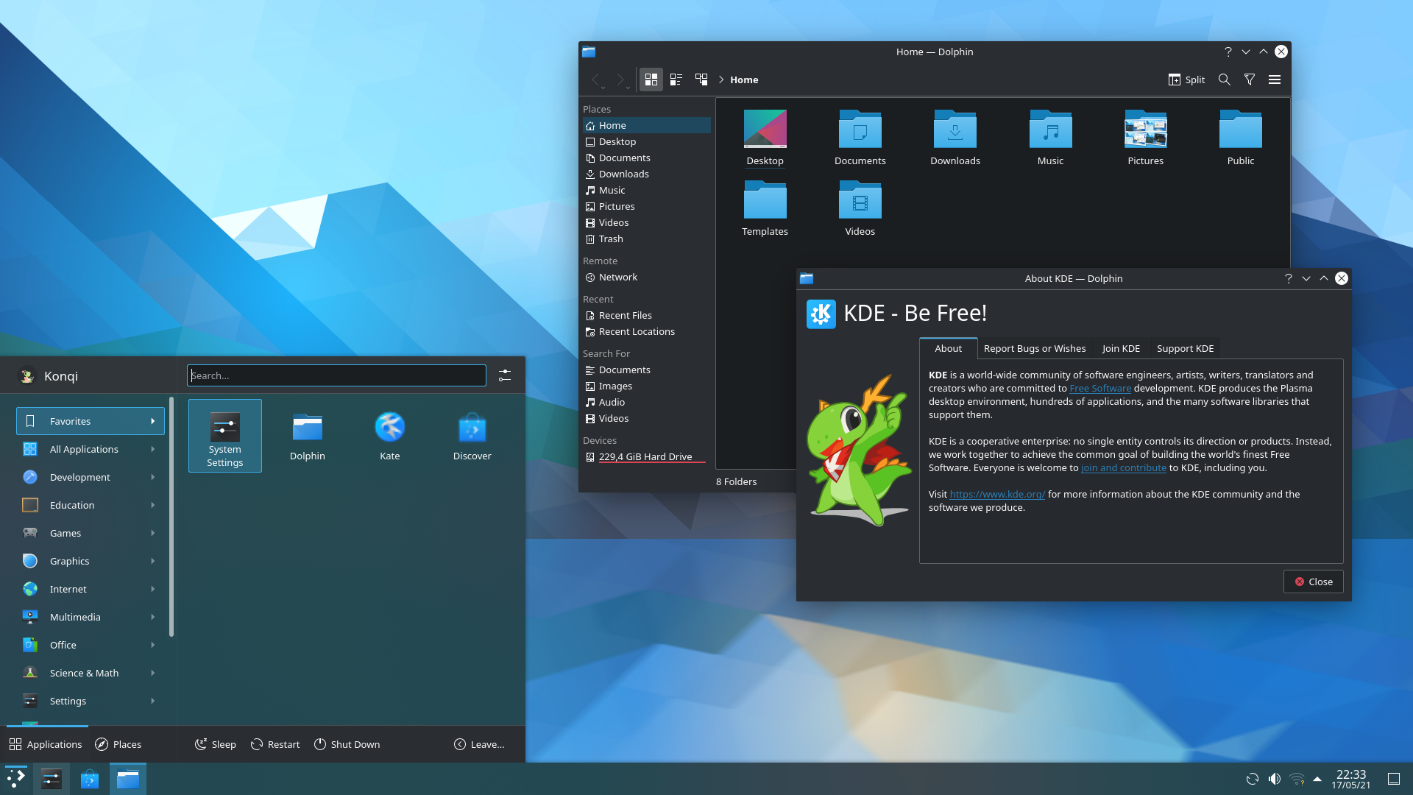
KDE

Slide 12
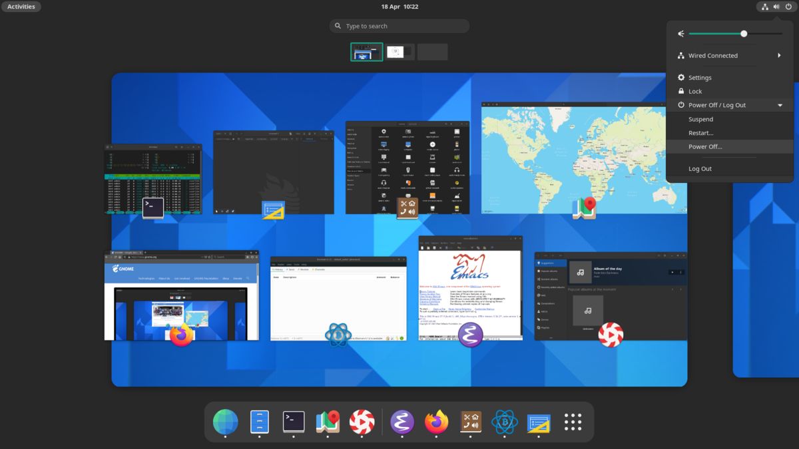
GNOME

Slide 13
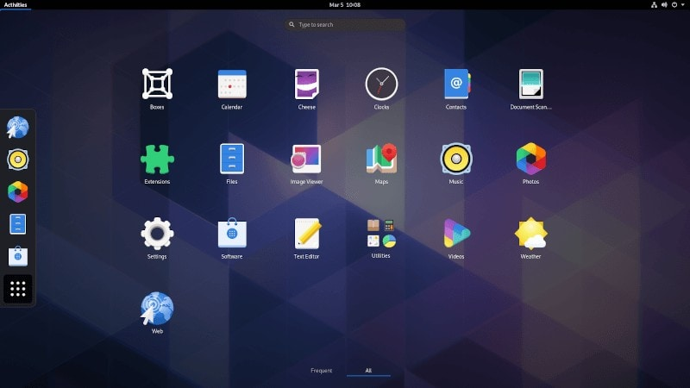
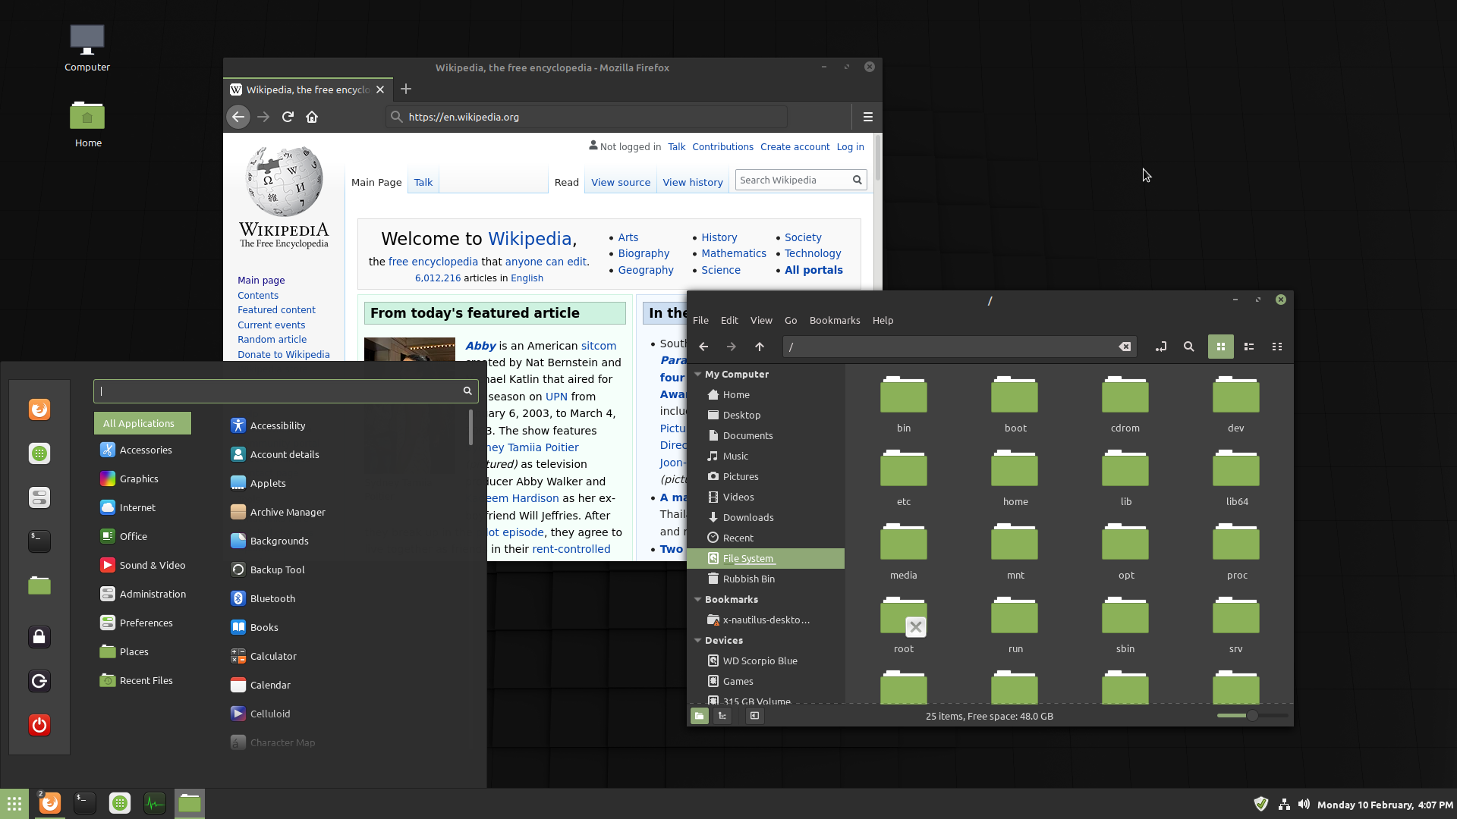
CINNAMON

Slide 14
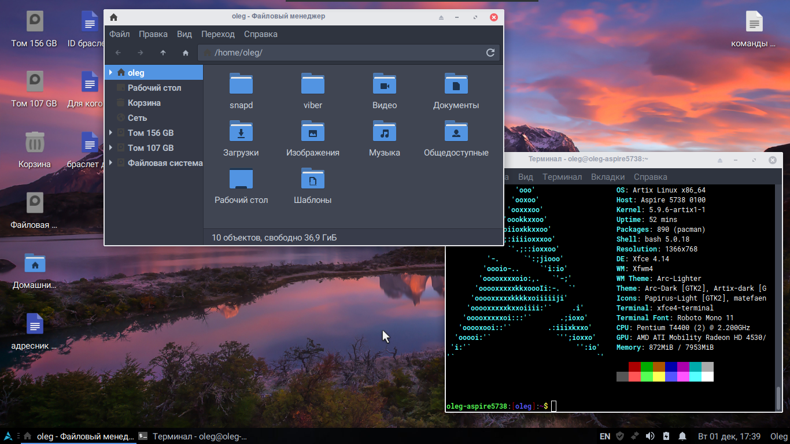
Xfce

